Slide 1
NexusEdge: Leveraging IoT Gateways for a Decentralized Edge Computing Platform
Nabeel Nasir, Victor Ariel Leal Sobral, Li-Pang Huang, Bradford Campbell
University of Virginia
7th ACM/IEEE Symposium on Edge Computing (SEC), 2022

Slide 2
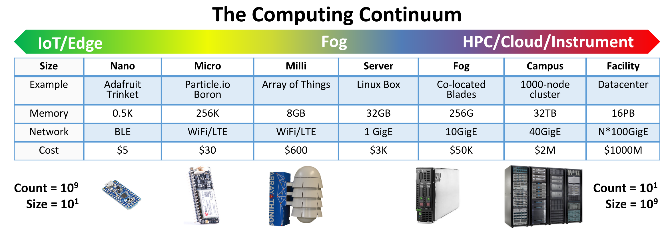
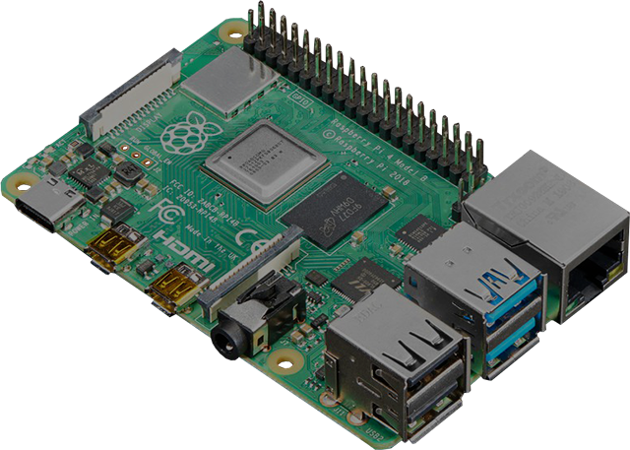
A look back at last year’s SEC Keynote
Raspberry Pi
4GB
WiFi
$40
Can we utilize
Gateways for
Edge Computing?
Pete Beckman et al., “Harnessing the Computing Continuum for Programming Our World.” Fog Computing, 1st ed., Wiley, 2020

Slide 3
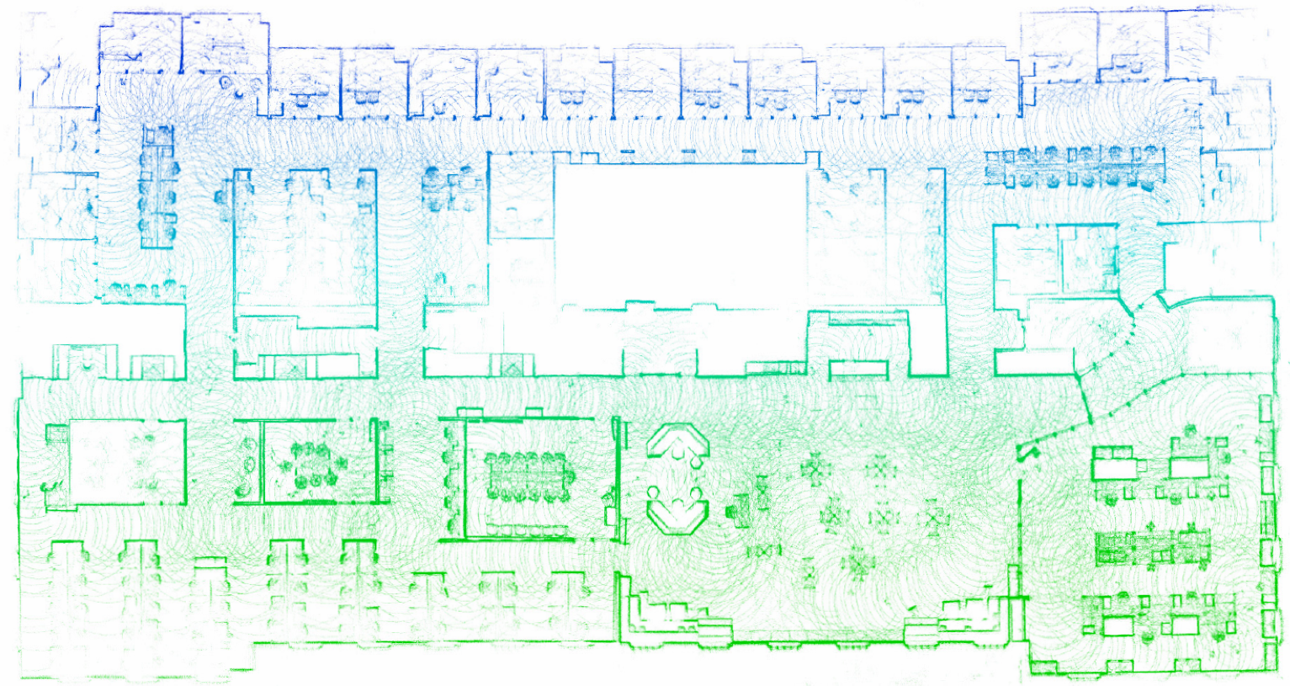
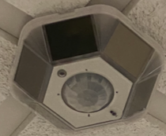

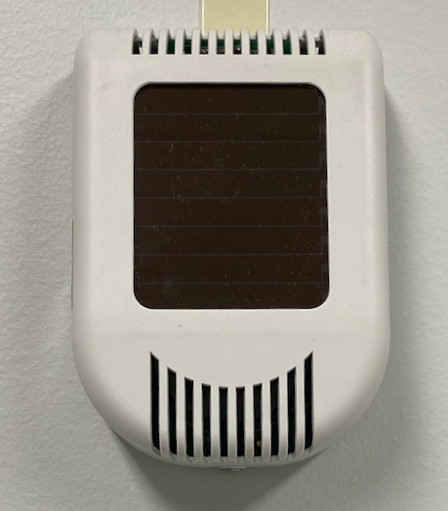
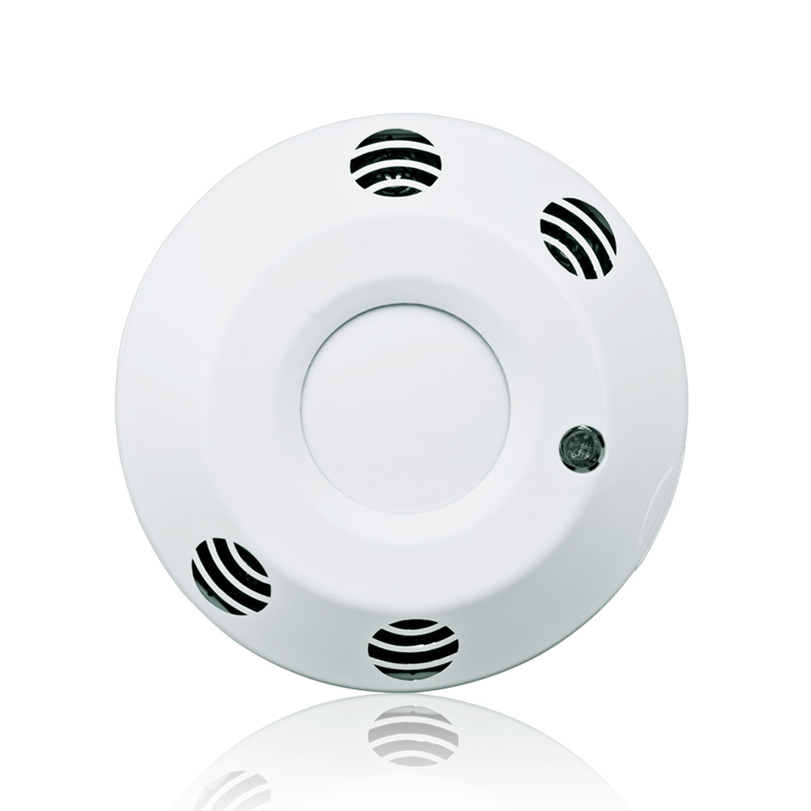
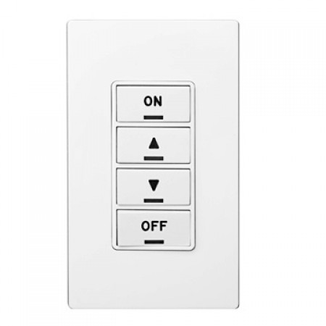
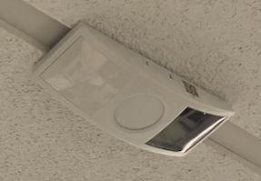
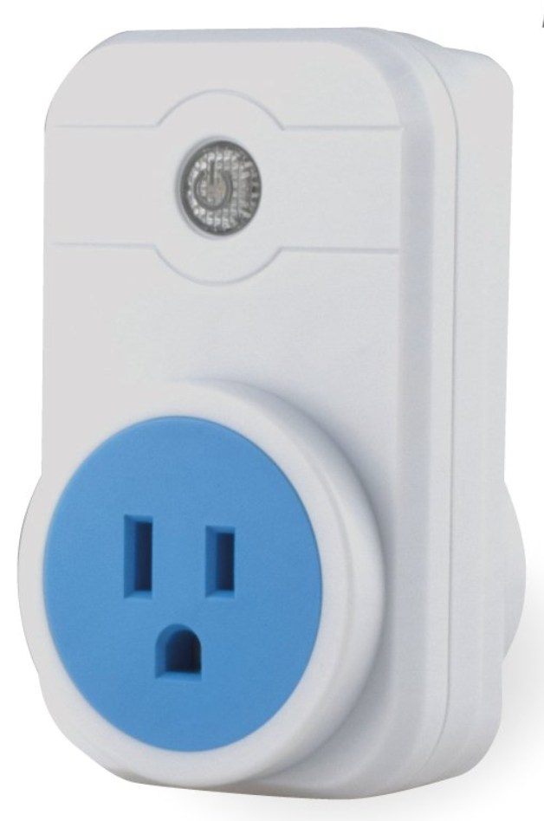
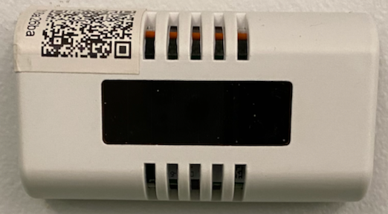
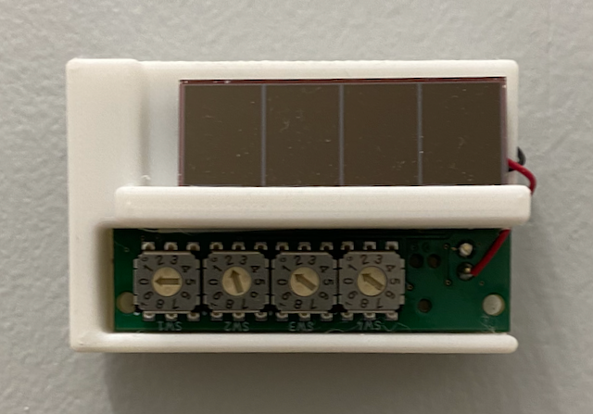
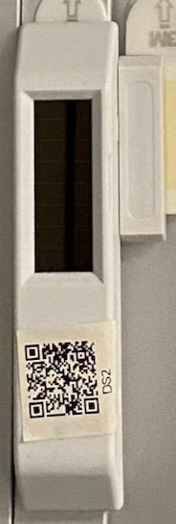
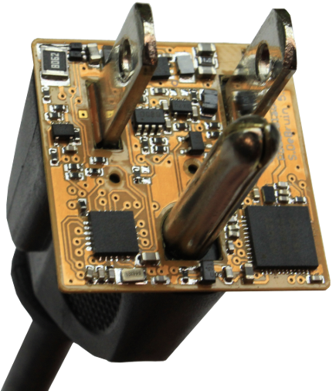
Collecting Data from ~200 IoT Devices in Our Test Bed
Occupancy Sensor
Estimote Beacon
CO2 Sensor
Leviton Lighting Control
Gateway 3
Light Level Sensor
Gateway 1
Smart Socket
Temperature Sensor
Herald Beacon
Gateway 4
Power Monitor
Door Contact Sensor
Gateway 2
Gateway 5
Notes:
Decided to deploy multiple sensors
Deployed around 200 sensors
We used some raspberry pi 4s to collect data from these sensors
We did some measurements of the gateways

Slide 4
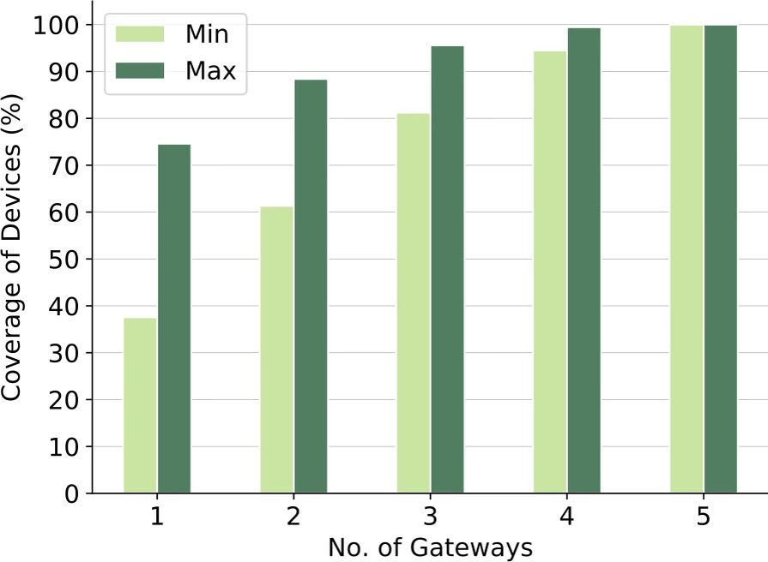
Gateways are Necessary but Underutilized
Gateways necessary to cover IoT devices
Have underutilized computational power
Notes:
Data for 30 days

Slide 5
Maximize Utility of Gateways for EC before relying on Servers
Cloud
Edge Server
Gateways
Devices
Notes:
Cloud
Support responsive edge applications and cutting edge IoT devices using a distributed network of IoT gateways without requiring edge servers.

Slide 6
Gateways offer Some Advantages over Server Machines
Better deployment flexibility
Wireless radios to communicate with IoT devices (one hop from devices)
Substantially lower cost (servers are $1000+)
No need to streaming all data to a centralized point
Also, IoT gateways are becoming better performant
Notes:
Reduce network traffic and application latency
Spatially large deployments already have multiple gateways for network coverage, and leveraging them increases their value without incurring additional hardware and installation costs

Slide 7
What kind of Edge Applications can we run on these gateways?
Not suitable for:
Compute-intensive
High storage apps
Examples: Live Video Analytics, Augmented Reality
Suitable for:
Long running applications
Operates on streaming data
Low to Moderate storage
Low to Moderate compute

Slide 8
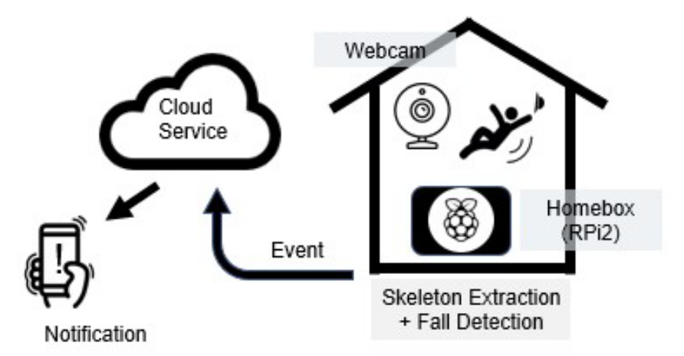
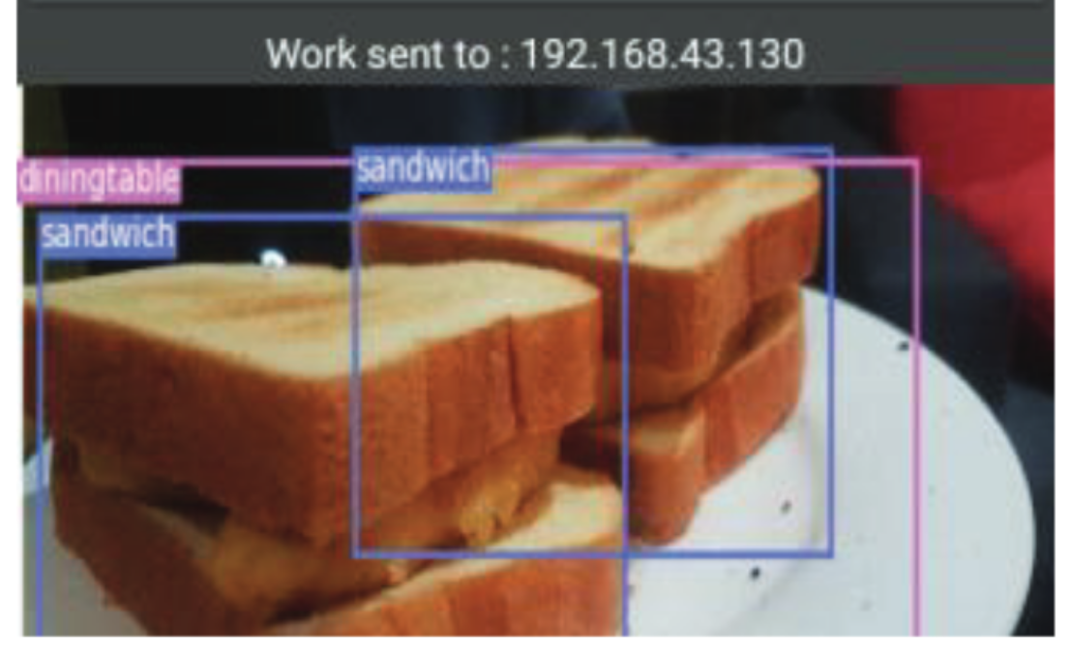
Machine Learning at the Edge
Elderly Fall Detection [1]
Object Detection [2]
[1] Hsu et al. “Fallcare+: An iot surveillance system for fall detection”, IEEE International conference on applied system innovation (ICASI), 2017.
[2] S. Tuli et al. “Edgelens: Deep learning based object detection in integrated iot, fog and cloud computing environments”, IEEE ISCON, 2019.

Slide 9
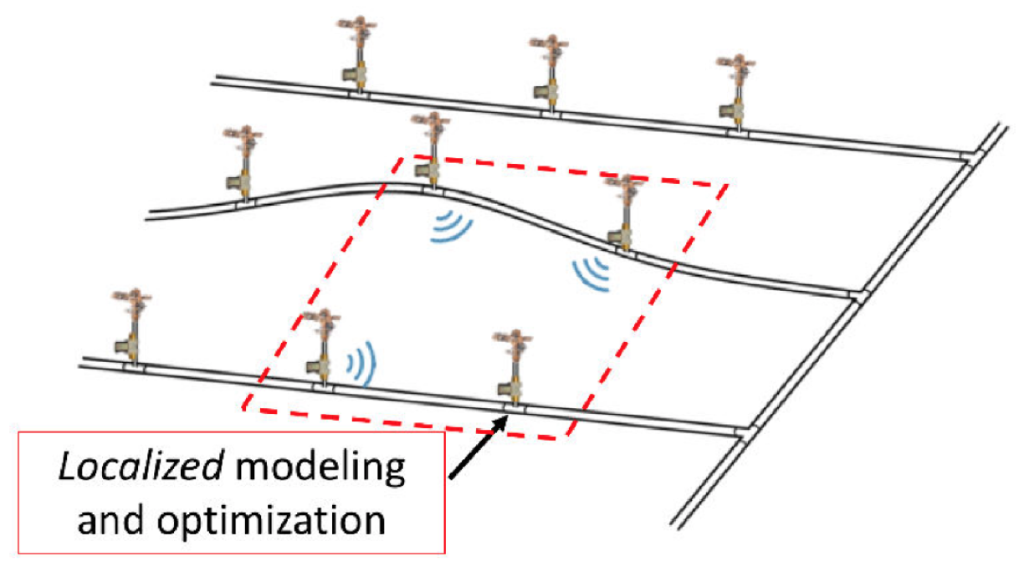
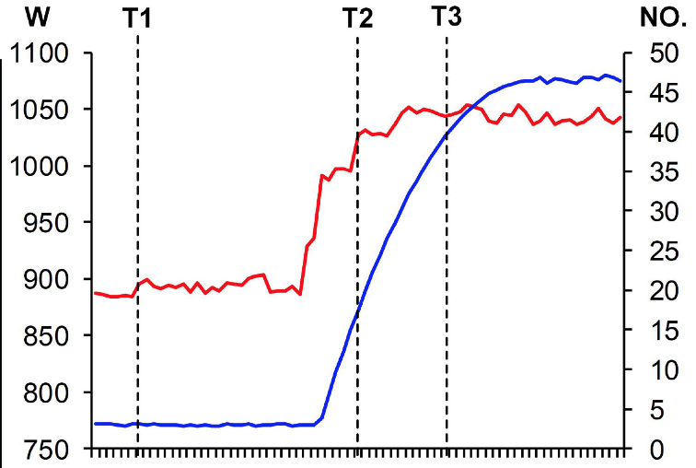
Large Scale Sensing and Actuating
Distributed Soil Moisture Control [5]
Occupancy based Building Energy Forecasting [6]
[5] D.A.Winkler et al. “Wisdom: watering intelligently at scale with distributed optimization and modeling,” ACM SenSys, 2019.
[6] Y. Tang et al. “Establishment of enhanced load modeling by correlating with occupancy information,” IEEE Transactions on Smart Grid, 2019.

Slide 10
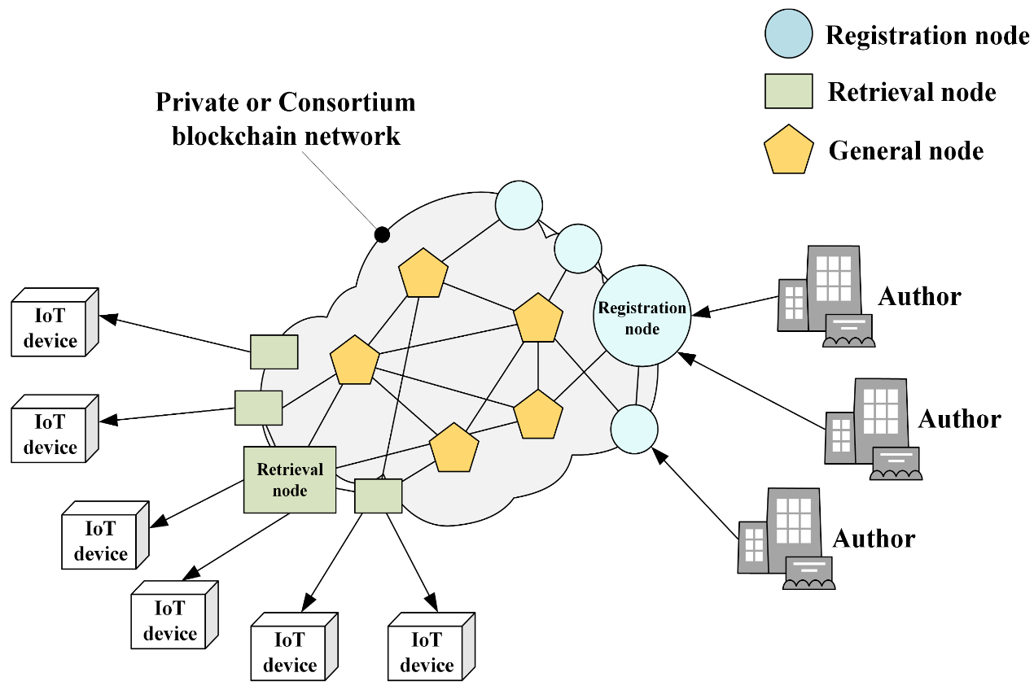
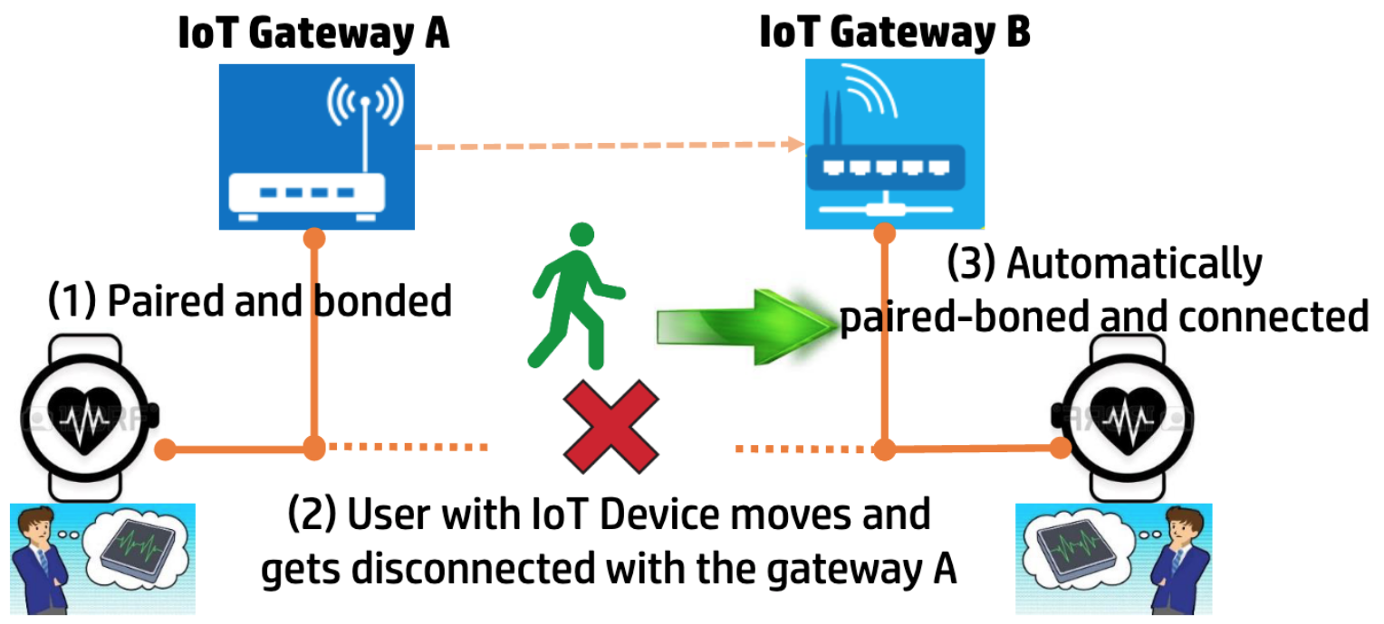
Inherently Distributed Applications
BLE Pairing Handoff across IoT Gateways [3]
Distributed Firmware Update for IoT Devices [4]
[3] S. R. Hussain et al. “Seamblue: Seamless bluetooth low energy connection migration for unmodified iot devices,” ACM EWSN, 2017.
[4] S. Choi et al. “Blockchain-based distributed firmware update architecture for iot devices,” IEEE Access, 2020.

Slide 11
Building An Edge Platform on Gateways poses some Challenges
Scaling up with multiple gateways has configuration overhead
IoT devices use heterogeneous communication techniques
Application development on a distributed network is complex
Managing apps and devices without a central point is hard
Gateways are not as resilient as server machines
Middleware on Gateways to collaborate and execute applications!

Slide 12
Some related works exist, but have limitations
Theme | Paper | Limitations
Gateway Coordination | Ooi et al. [1] | - Cannot execute edge applications
 | Clemente et al. [2] | - Doesn’t handle device heterogeneity - Interfaces with devices & apps not defined
IoT Middleware | ThingsJS [3] | - Excludes low-power and harvesting devices - Overhead for obtaining device streams
 | Hive Middleware [4] | - Not resilient to failures - Data locality not considered in scheduling
[1] Ooi et al. “A collaborative iot-gateway architecture for reliable and cost effective measurements,” IEEE Instrumentation & Measurement, 2019.
[2] Clemente et al. “Fog computing middleware for distributed cooperative data analytics”, IEEE Fog World Congress (FWC), 2017.
[3] Gascon-Samson et al. “Thingsjs: Towards a flexible and self-adaptable middleware for dynamic and heterogeneous iot environments”, 4th Workshop on Middleware and Applications for the Internet of Things, 2017.
[4] Essameldin et al. “More than the sum of its things: Resource sharing across iots at the edge”, IEEE/ACM Symposium on Edge Computing (SEC), 2020.

Slide 13
NexusEdge Middleware on Gateways to Handle Challenges
Application
&
Management
Layer
Middleware
Middleware
Gateway 3
Platform
Layer
Middleware
Gateway 1
Middleware
Hardware
Layer
Gateway 2
Gateway 4
Notes:
These are the gateways we’ve deployed in the link lab

Slide 14
Middleware on Gateways to Handle Challenges
Gateway discovery for scalability
Supports IoT device handling
Encapsulates current network
Application
&
Management
Layer
Platform
Layer
Hardware
Layer
Notes:
discovery - why BLE, why not some other?

Slide 15
Using a Link Graph to Encapsulate Network Information
IoT environments are dynamic: devices and gateways could join and leave
For gateways to coordinate, each gateway needs to know:
What other gateways are present
What other devices are present
Which gateways can communicate with which devices
Generating link graph: Ask neighbors, they ask their neighbors,…

Slide 16
Challenging to Develop Apps when Devices are Distributed
NexusEdge Gives Developers an Abstracted Single Gateway View
temp2
temp4
lightcontrol1
lightcontrol2
Gateway 3
Gateway 1
Gateway
temp3
temp1
Gateway 2
lightcontrol3
Gateway 4

Slide 17
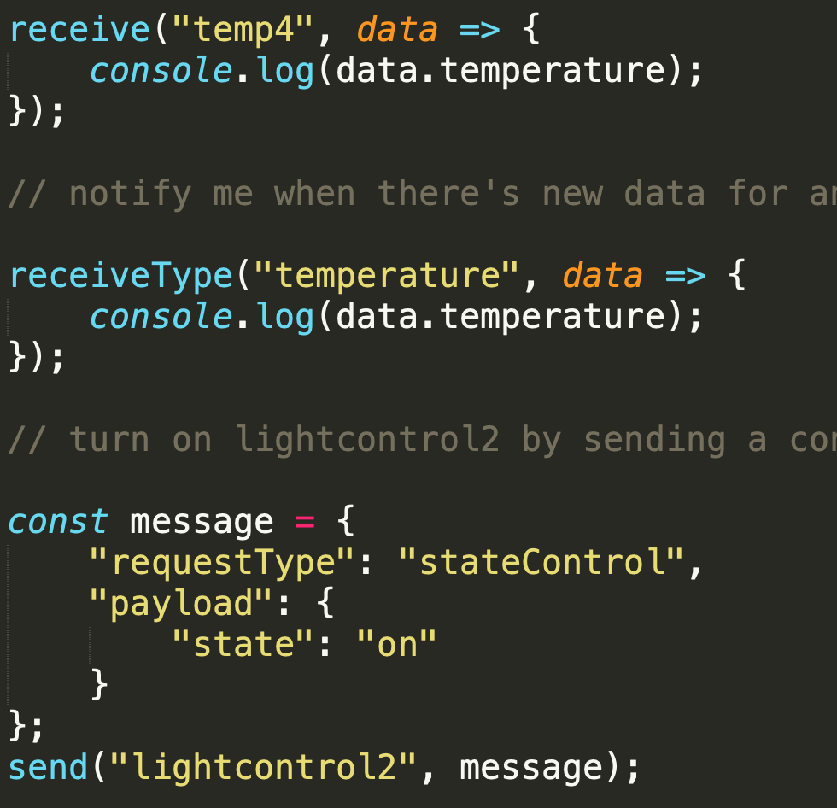
APIs to Provide Simplicity in Device Interaction
Receive data streams from temp4
temp2
temp4
lightcontrol1
lightcontrol2
Receive data streams from all temperature sensors
Gateway
Turn on lightcontrol2 by sending a control message
temp3
temp1
lightcontrol3

Slide 18
Middleware on Gateways to Facilitate this Shift
Gateway discovery for scalability
Supports IoT device handling
Encapsulates current network
Distributed services to handle devices, applications, and data streams
Device interaction API hides underlying network complexity from apps
Provides remote management
Application
&
Management
Layer
Platform
Layer
Hardware
Layer

Slide 19

NexusEdge uses Device Locality to Schedule Applications
temp1
temp2
temp3
App
Devices Needed
Middleware
Middleware
Middleware
Middleware
schedule
Auxiliary
Device
provider
gateway
Gateway 1
Gateway 2
Gateway 3
executor
gateway
Gateway 4
Device connection
Data stream flow
temp1
temp2
temp3
lightcontrol1
lightcontrol2
Notes:
Also does load balancing

Slide 20
Resiliency: Migrates App if Executor Gateway Fails
temp1
temp2
temp3
App
Devices Needed
Middleware
Middleware
Middleware
Middleware
executor
gateway
Auxiliary
Device
provider
gateway
Gateway 1
Gateway 2
Gateway 3
executor
gateway
Gateway 4
Device connection
Data stream flow
temp1
temp2
temp3
lightcontrol1
lightcontrol2

Slide 21
Resiliency: Provide Alternative Streams (if possible) when Provider Fails
temp1
temp2
temp3
App
Devices Needed
Middleware
Middleware
Middleware
Middleware
Auxiliary
Device
provider
gateway
Gateway 1
Gateway 2
Gateway 3
executor
gateway
Gateway 4
provider
gateway
Device connection
Data stream flow
temp1
temp2
temp3
lightcontrol1
lightcontrol2

Slide 22

NexusEdge is open-source, containerized and Kubernetes-friendly
Implementation is open source
github.com/uva-linklab/nexusedge
Containerized with Docker
Handles gateway heterogeneity and improves deployability
Can be orchestrated using K3S (Lightweight Kubernetes)
DaemonSet to deploy middleware on all gateways
Notes:
Gateway devices are heterogeneous and have different hard- ware or runtime environments with various subtle differences. To handle this heterogeneity, we containerize our middleware using Docker [63] to provide operating system-level virtualization. This vastly improves the ease of deployment, and abstracts out the hardware, OS, and runtime environment. The NexusEdge Docker container is public on Docker Hub [64].
Additionally, to reduce the tedious burden of deployment on many gateways, we utilize K3S [65], a lightweight version of Kubernetes [66] container orchestrator built for IoT and Edge Computing. Gateways join a cluster, and the cluster executes a DaemonSet [67] to start the NexusEdge container on all cluster nodes. DaemonSet ensures that NexusEdge starts automatically on all new gateways

Slide 23
Scalability with Devices and Applications
Comparison of decentralized NexusEdge vs a centralized server-based architecture
Decentralized NexusEdge Architecture
Centralized Edge Server Architecture

Slide 24
Scalability with No. of IoT Devices
Setup
Edge Server: 4 Raspberry Pis as Gateways, 1 Raspberry Pi as Server
NexusEdge: 5 Raspberry Pis as Gateway, no Server
Measure:
CPU usage
Memory usage
Network traffic

Slide 25
Comparison with Centralized Architecture
a) Scalability with No. of IoT Devices
Devices Simulated for the evaluation:
125 devices equally distributed on server and gateways, i.e. each hosting 25 devices
Sensor | Data Rate | Count
Temperature Sensor | 100 bytes / 5 mins | 50
Occupancy Sensor | 100 bytes / 5 mins | 50
CO₂ Sensor | 100 bytes / 15 mins | 10
Smart Meter | 500 bytes/s | 10
Camera | 100 KB/s (assuming 720p at 15fps) | 5
 |  | 125 (total)

Slide 26
Scales well with more IoT devices
Network Traffic
CPU Usage
Memory Usage
Avg.
CPU
Usage
(%)
Avg.
RAM
Usage
(MB)
NW
Traffic
(KB/s)
No. of Devices
No. of Devices
No. of Devices
NexusEdge has substantially lower network traffic
NexusEdge gateways only stream data when applications require it
Resource usages slightly higher for Edge Server architecture to handle data flooding

Slide 27
Scalability with No. of Edge Applications
Setup
Edge Server: 4 Raspberry Pis as Gateways, 1 Raspberry Pi as Server
NexusEdge: 5 Raspberry Pis as Gateway, no Server
Measure:
CPU usage
Memory usage
Network traffic
End-to-End Latency (from device to application)

Slide 28
Scalability with No. of Edge Applications
Devices Simulated for the evaluation:
Sensor | Data Rate | Count
Temperature Sensor | 100 bytes / 5 mins | 50
Occupancy Sensor | 100 bytes / 5 mins | 50
CO₂ Sensor | 100 bytes / 15 mins | 10
Smart Meter | 500 bytes/s | 10
Camera | 100 KB/s (assuming 720p at 15fps) | 5
 |  | 125 (total)
Notes:
We simulated 10 smart meters at 500 bytes/s,
50 temperature sensors at 100 bytes every 5 min.,
50 occupancy sensors at 100 bytes every 5 min.,
10 CO2 sensors at 100 bytes every 15 min., and
5 IP cameras at 100 KB/s assuming 720p at 15 fps.

Slide 29
Scalability with No. of Edge Applications
App | Sensors Used
Power meter anomaly detection | 10 Smart meters
Object detection in secure areas | 5 Cameras
User comfort monitor | 50 Temperature Sensors
Air quality monitoring | 10 CO₂ Sensors
Room scheduling | 50 Occupancy Sensors
Notes:
1) Power meter anomaly detection: Monitors power meter data from 10 smart meters, and sends an alert if it detects a spike in the power profile.
2) Object detection in secure areas of building: Obtains the camera feed from five IP cameras, extracts images from them, and uses a machine learning model trained on the ImageNet dataset, to check for any suspicious objects.
3) User comfort monitor: Collects data from the 50 temperature sensors from different office rooms and open areas, monitors for overheating or overcooling, and sends alerts to facilities.
4) Air quality monitoring: Periodically checks readings from ten CO2 sensors and alerts if certain areas cross dangerous ppm levels.
5) Room scheduling: Collects information from all occupancy sensors from the building floor to display available conference rooms.

Slide 30
b) Scalability with No. of Edge Applications
Three different device distributions
Colocated: Devices required for app available on executing gateway/server
Distributed: Devices required for app equally distributed on all five nodes
Random: Devices randomly distributed on all five nodes
Notes:
“As the resource usage, traffic, and latency differ based on how devices are distributed, we consider three different types of device distributions”

Slide 31
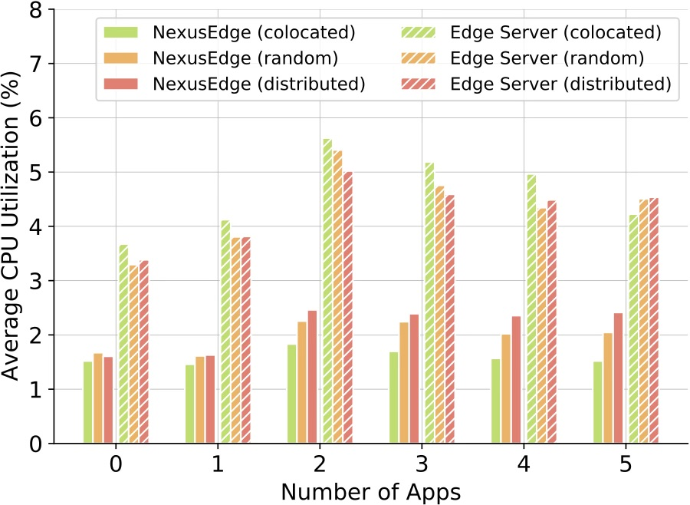
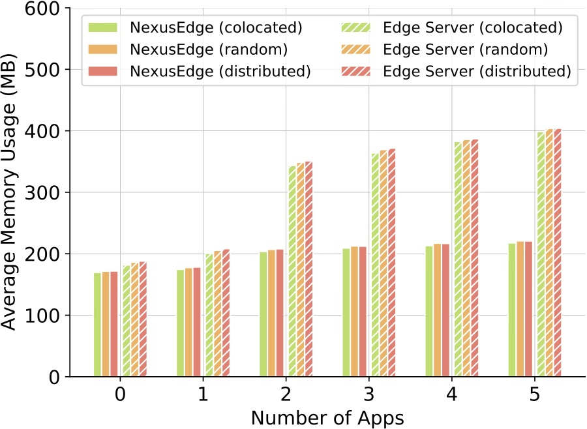
b) Scalability with No. of Edge Applications
Memory usage of ES is ~90% higher than NexusEdge, across distributions
Reason: Single edge server to execute applications
CPU and memory usages in NexusEdge are very low, < 3% and 250 MB (out of 4GB) with 5 apps
Shows potential to run edge applications

Slide 32
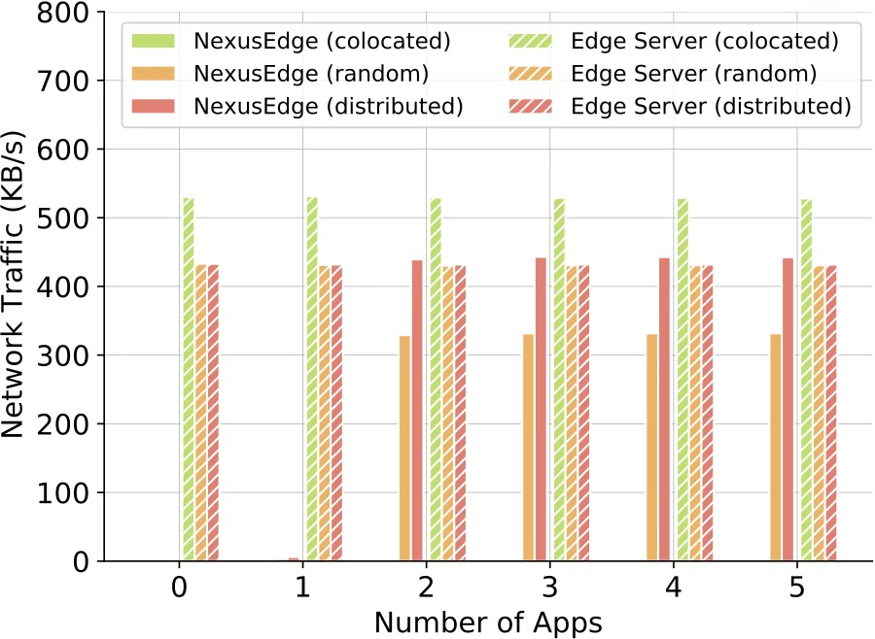
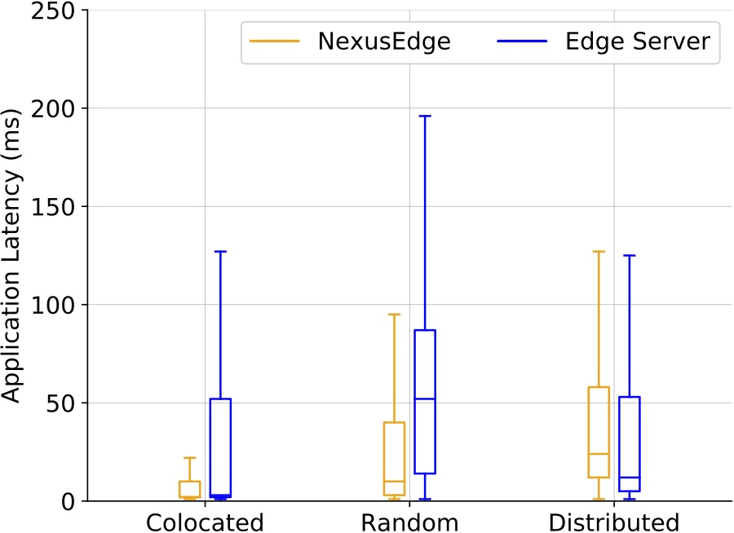
Scales well with more edge applications
Centralized architecture suffers from high network traffic
NexusEdge utilizes locality of data while scheduling applications
NexusEdge offers substantially better application latency (except for the distributed case)
Notes:
For distributed case, applications end up needing data from all gateways, effectively performing similar to the centralized ES arch

Slide 33
Comparison with AWS IoT Greengrass
We compare against Amazon’s AWS IoT Greengrass
Edge Computing platform that follows a Centralized architecture
Evaluation Setup
Use 70 sensors from our testbed: temperature and occupancy
App: Send alert for suboptimal cooling and wasted energy
Run application and measure network traffic and end-to-end latency
Notes:
To validate our findings from previous study

Slide 34
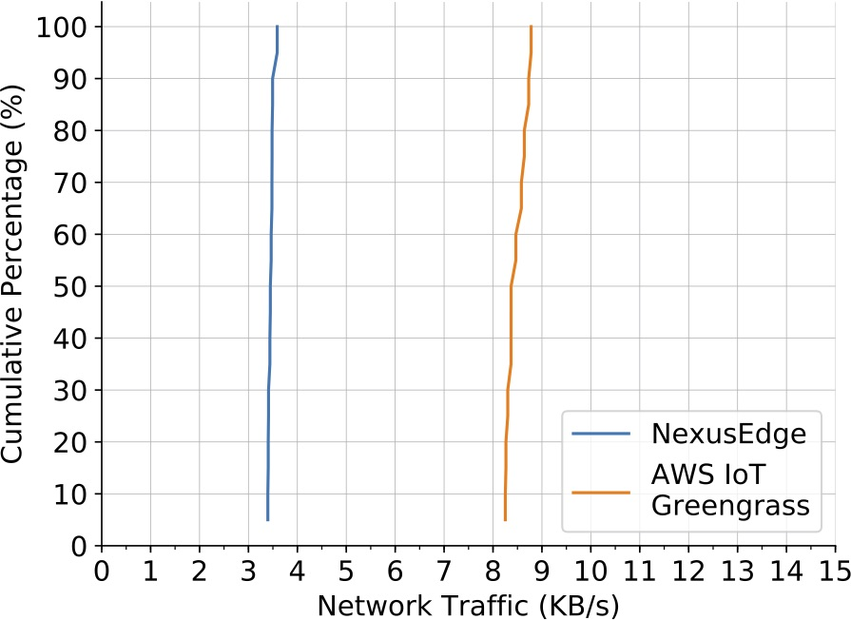
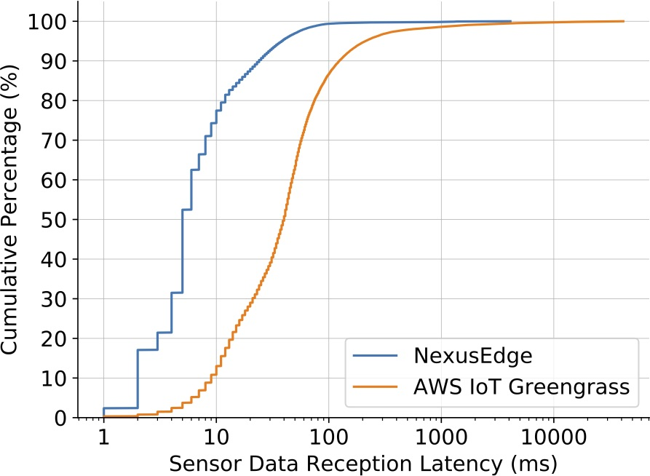
Improved Traffic and Latency Compared to Greengrass
Mean Traffic: 3.46 KB/s vs 8.48 KB/s
(2.5x lower)
Mean Latency: 13.83 ms vs 142.74 ms
(10x faster)
Notes:
CDF for the network traffic and the latency it takes for a simulated sensor to create a data and to the application to actually use the data
Example for ultra low latency app: human perception on AR, app which operates by correlating events (timing is critical)

Slide 35
Decentralization Overhead
Gateways have some decentralization overhead for gateway coordination
For servers, no scheduling is needed
Deploy an app and measure deployment time on server vs gateways
Notes:
For server, no scheduling needed
For NexusEdge, send application to scheduling gateway, generating link graph, scheduling the application, dispatching the application to an executing gateway, setting up streams from provider gateways, and subscribing to all data streams

Slide 36
NexusEdge has reasonable Decentralization Overhead
Deployment time of NexusEdge is 1110.4ms compared to 690.1ms for centralized
Overhead: 420ms
Notes:
decentralization overhead - is this overhead okay?
- Okay since we deal with only long running app deployments

Slide 37
Resiliency to Gateways Failures
Measure resiliency response time to failures
NexusEdge provides resilience for:
Executor Failure: If a gateway executing an app fails, it’s migrated to a different gateway
Provider Failure: If a gateway providing data streams to an app fails, the middleware tries to reinstate data streams from alternative sources

Slide 38
NexusEdge Quickly Migrates Apps when Gateways Fail
Fail the executor gateway and measure migration time
Migrating an app using 100 data streams takes ~1.2s
Migration time increases linearly

Slide 39
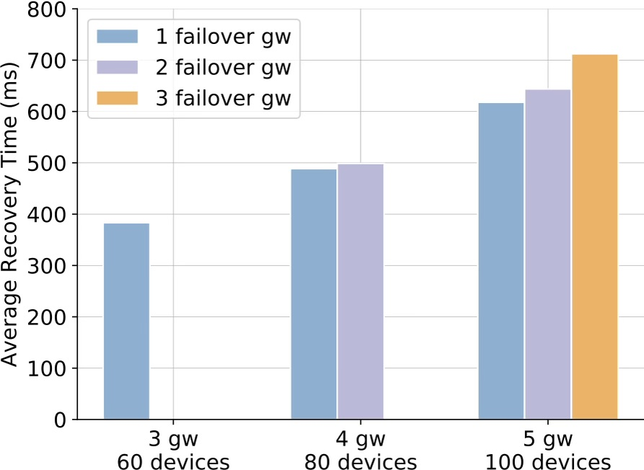
NexusEdge Quickly Reinstates Streams
Measure response time to reinstate stream from a failover gateway
Fast recovery: 712.3ms even with 5 gateways, 100 devices
Notes:
Both experiments highlight significance of our middleware in building a cohesive edge platform with gateways, that can operate with resiliency without suffering from a single point of failure

Slide 40
Case Study: Distributed Federated ML
Implemented a distributed federated machine learning without cloud support
Uses several distributed APIs provided by the middleware

Slide 41
Limitations and Future Work
Currently offers limited security provisions
Interfaces for device registration, discovery, and auxiliary devices could be updated
Task scheduler to improve QoS of edge apps by utilizing heterogeneity of edge hardware
Device stream routing for user-driven privacy policy enforcement
Notes:
Security Challenges: Security is a major consideration for edge computing systems. We use a limited threat model in this work with preliminary security provisions. To enhance security, we need to explore different threat models for the platform, apps, devices, auxiliary devices, and data. Certain interfaces including device registration, gateway discovery, and auxiliary device connections, could support security features.

Slide 42
Takeaways
IoT Gateways are ubiquitous and becoming increasingly performant
Increase their utility in the computing continuum before depending on more powerful machines
NexusEdge middleware a first step towards a vision to democratize edge computing
Notes:
Make edge computing accessible to all

Slide 43
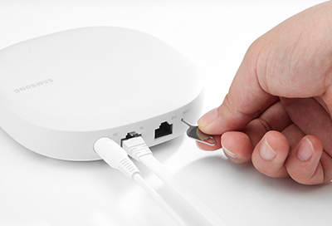

Thank You!
I’m on the job market!
Nabeel Nasir
www.cs.virginia.edu/~nn5rh

Slide 44
Backup Slides

Slide 45
Implementation Details
Notes:
Mqtt
Node.js, and python

Slide 46
APIs

Slide 47
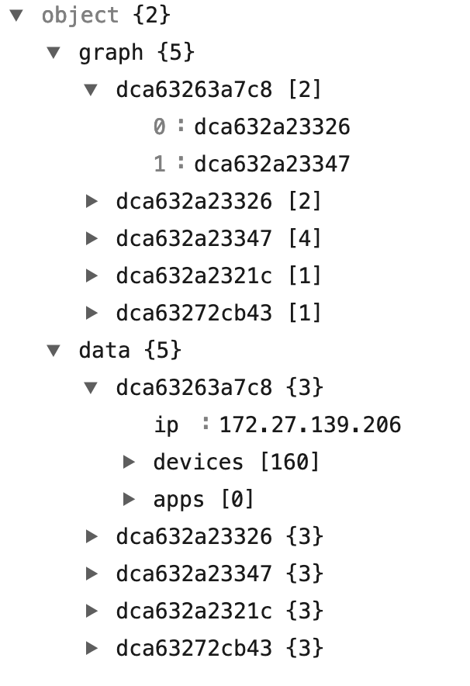
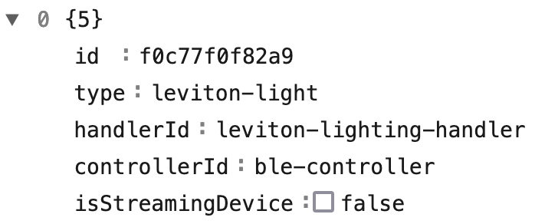
JSON representation of Link Graph
Gateway Id
Neighbor Graph of Gateways
Device Id
…
…
…
IP address,
Devices, and
Apps of each
gateway
Notes:
We use a graph data structure to encapsulate this information
Each gateway keeps track of its neighbors (from discovery) and devices

Slide 48
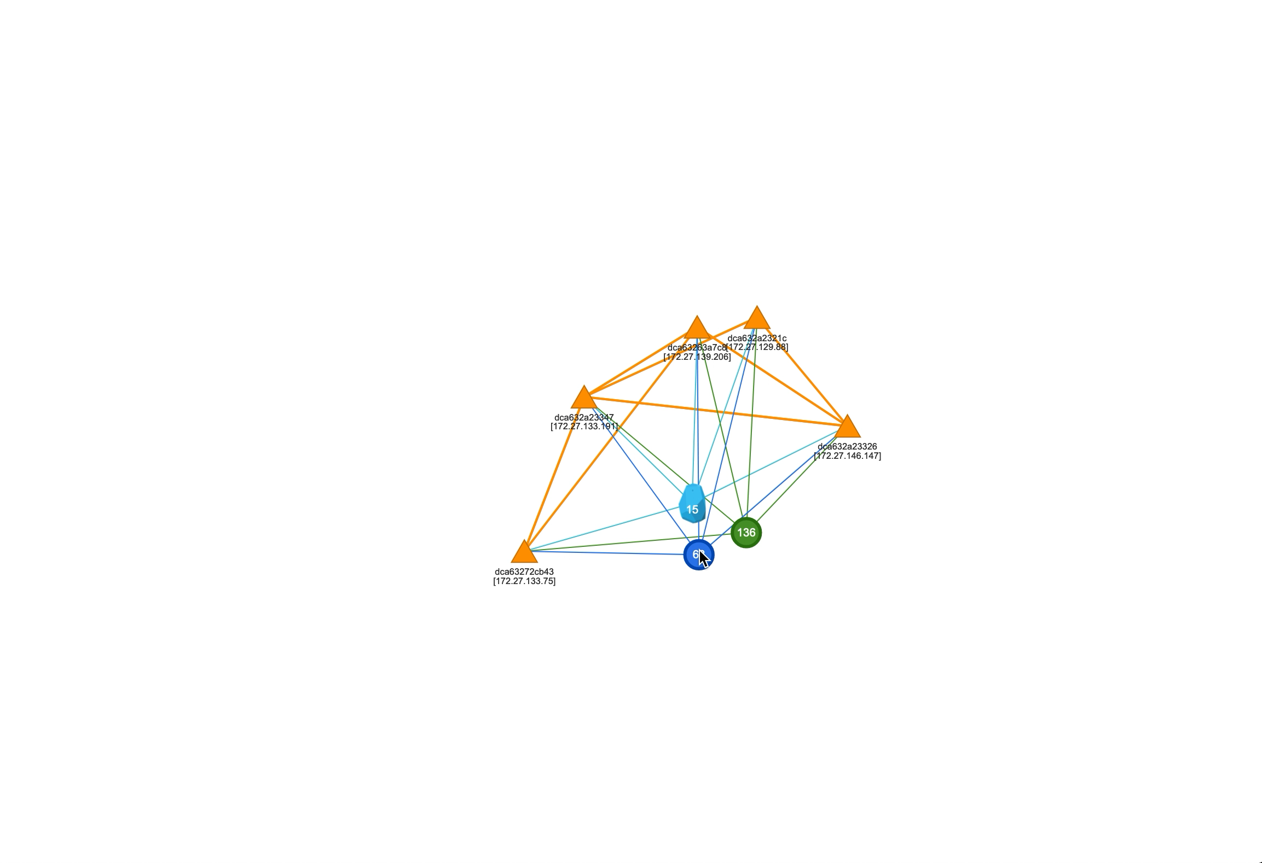
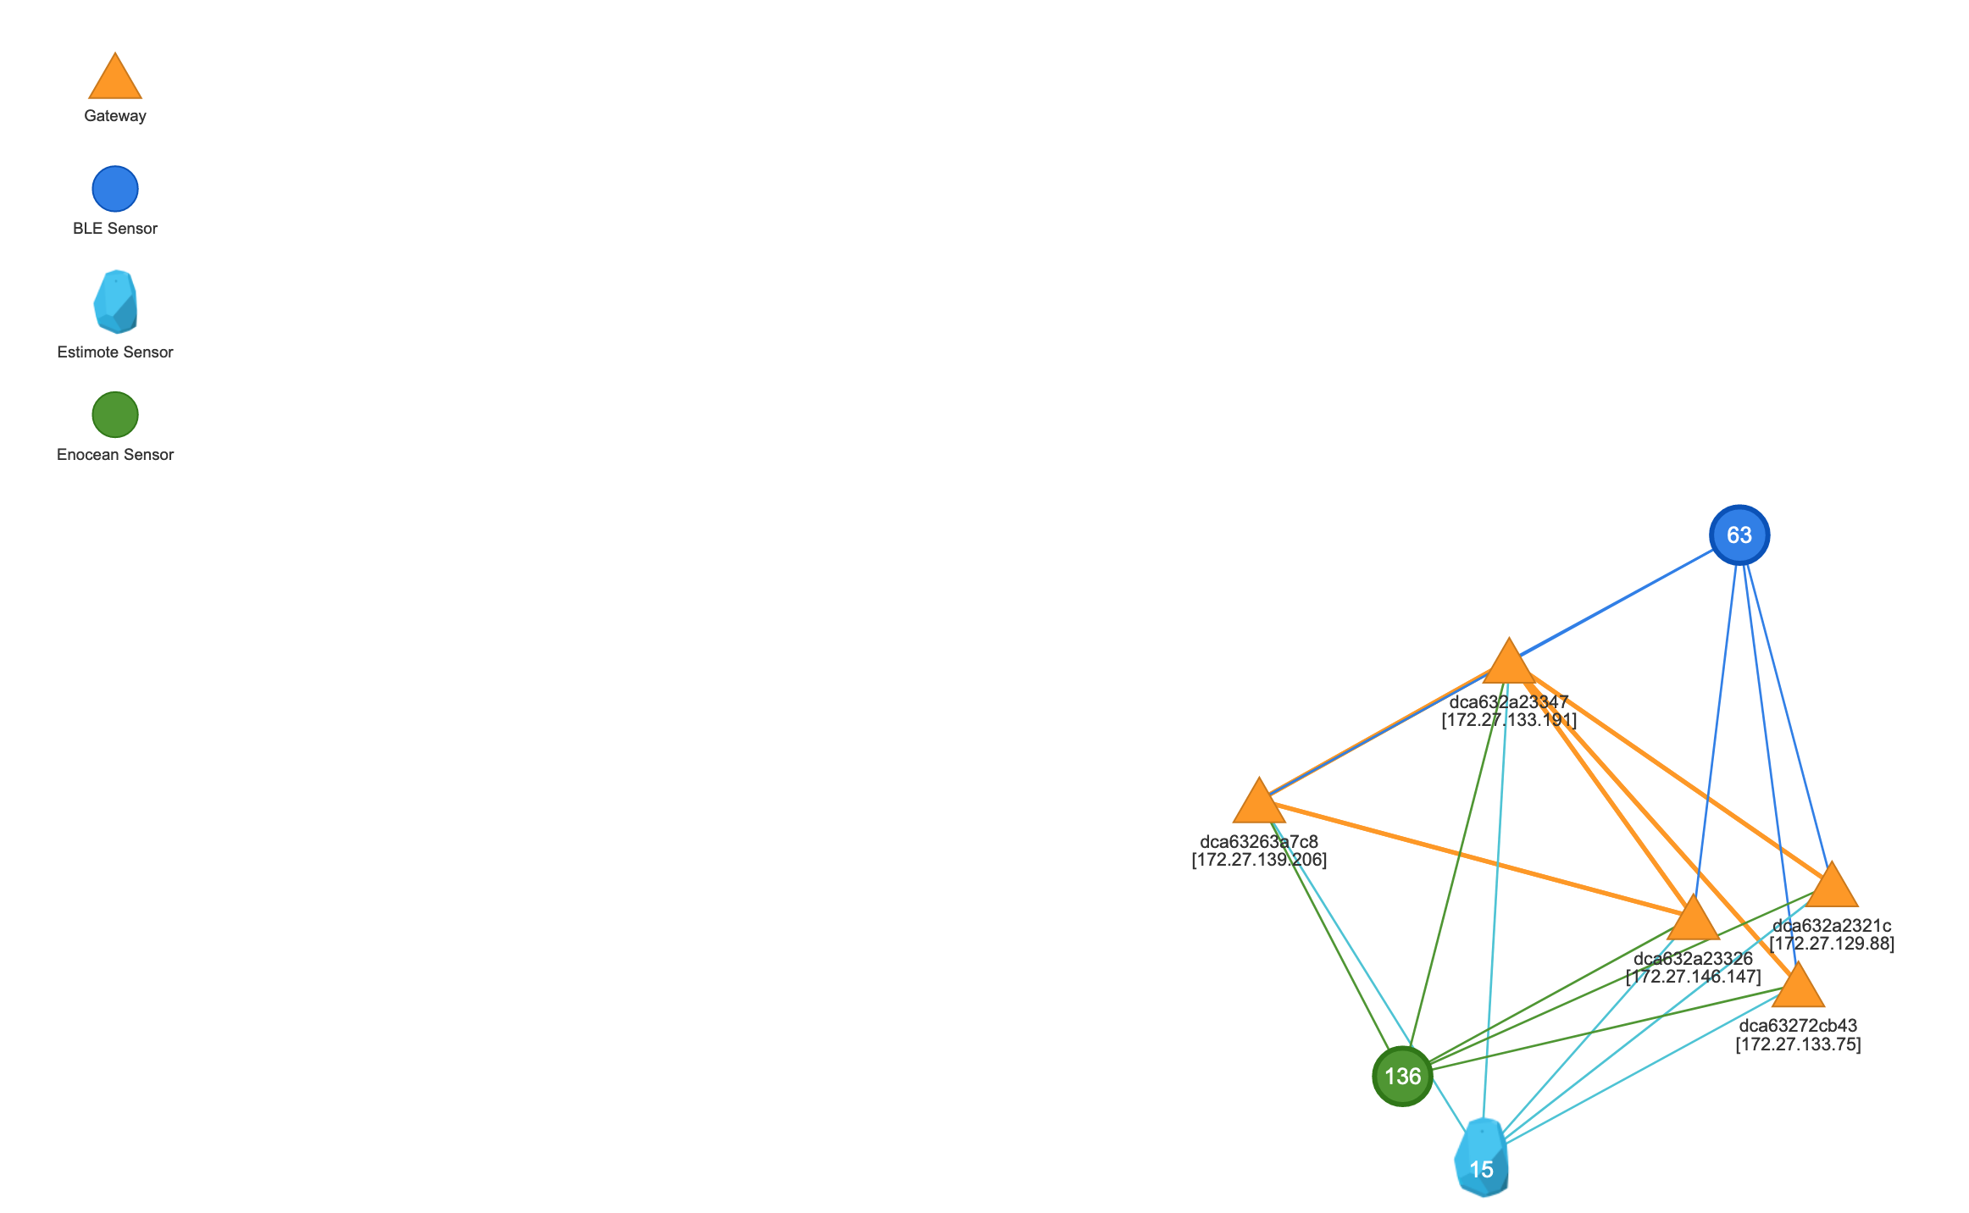
Visualization of Link Graph

Slide 49
Comparison with Centralized Architecture
b) Scalability with No. of Edge Applications
App | Sensors Used | Description
Power meter anomaly detection | 10 Smart meters | Alert for spikes in power profile
Object detection in secure areas | 5 Cameras | Detects suspicious objects using a MobileNetV2 model trained on ImageNet dataset
User comfort monitor | 50 Temperature Sensors | Alerts for overheating or overcooling
Air quality monitoring | 10 CO₂ Sensors | Alerts for dangerous ppm levels
Room scheduling | 50 Occupancy Sensors | Displays available conference rooms
Notes:
1) Power meter anomaly detection: Monitors power meter data from 10 smart meters, and sends an alert if it detects a spike in the power profile.
2) Object detection in secure areas of building: Obtains the camera feed from five IP cameras, extracts images from them, and uses a machine learning model trained on the ImageNet dataset, to check for any suspicious objects.
3) User comfort monitor: Collects data from the 50 temperature sensors from different office rooms and open areas, monitors for overheating or overcooling, and sends alerts to facilities.
4) Air quality monitoring: Periodically checks readings from ten CO2 sensors and alerts if certain areas cross dangerous ppm levels.
5) Room scheduling: Collects information from all occupancy sensors from the building floor to display available conference rooms.

Slide 50
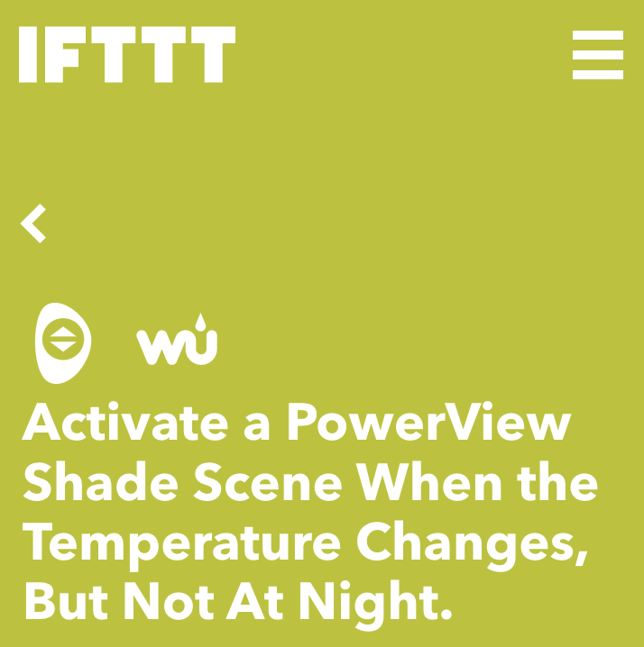

Simple If-this-then-that Applications
Window Blinds Control based on Weather [5]
Lights Control based on Smart Door Lock [6]
[5] IFTTT Applet. https://ifttt.com/applets/QxHysZRg
[6] IFTTT Philips Hue and August Lock. https://ifttt.com/applets/mqs4CUv9
Notes:
Simple If-this-then-that
Low storage
Low compute

